Slide 1

Inductive Knowledge Graph Embedding via Exploring Interaction Patterns of Relations
Chong Mu*, Lizong Zhang, Jinchuan Zhang, Qian Huang, Zhiguo Wang University of Electronic Science and Technology of China
muchong@std.uestc.edu.cn
Notes:
Actually, in this paper, we're trying to address knowledge graph completion in some challenging scenarios.

Slide 2
1. Background
Contents
2. Task Definition and Method
3. Experiments
4. Conclusion

Slide 3
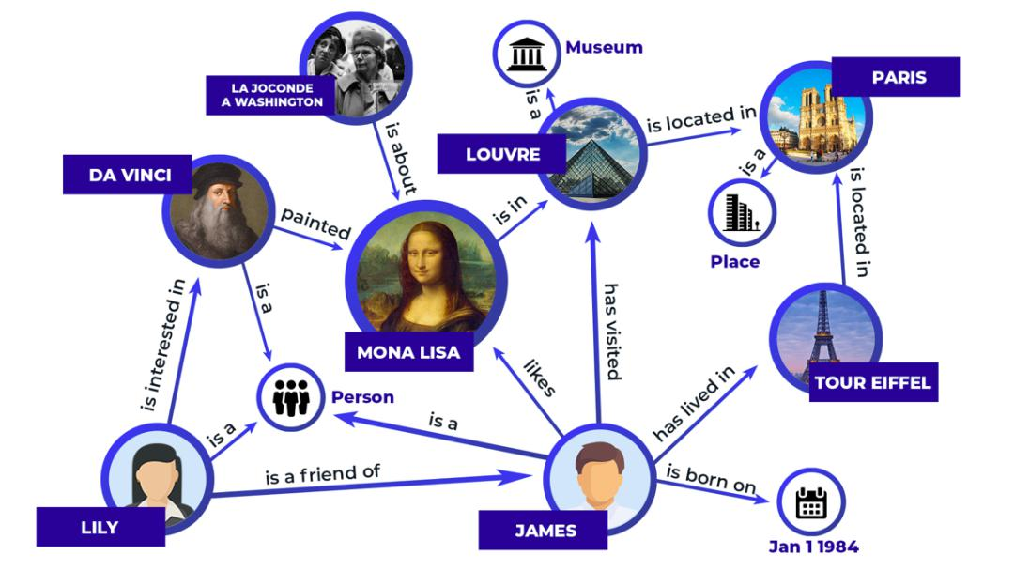
1. Background
Knowledge graph is a structured method for representing the real world——Basic unit：
(h, r, t)→ (head, relation, tail)
Notes:
Knowledge graph is a structured method for representing the real world.
Knowledge graphs are constructed by triplets. The form of a triplet is (h, r, t), where h and t are nodes representing entities, and r is a relation which represents a directed edge from h to t.

Slide 4
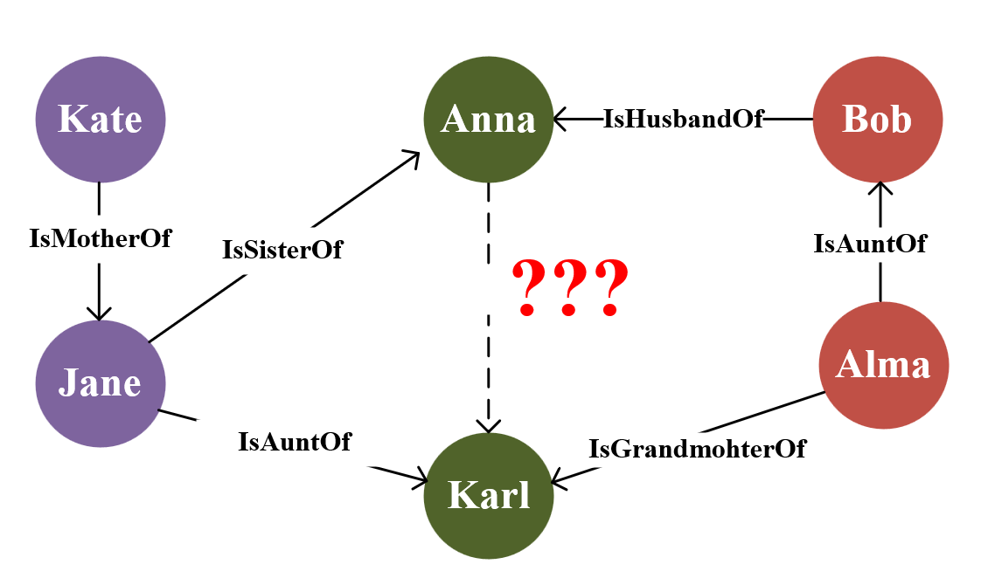
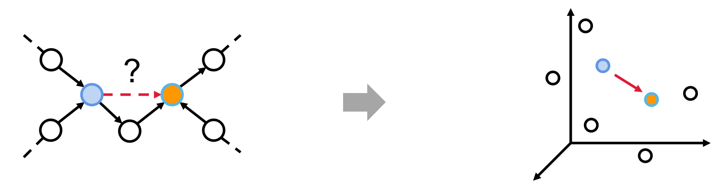
1. Background
Knowledge graph completion involves predicting missing entities or relations within knowledge graphs (KGs) and is crucial for constructing and maintaining KGs.
Embedding-based methods:
4
Notes:
Knowledge graph completion involves predicting missing entities or relations within knowledge graphs (KGs) and is crucial for constructing and maintaining knowledge graphs.
(点击弹出动画)
Knowledge graph embedding techniques provide an effective solution for knowledge graph completion by mapping entities and relationships to a low-dimensional vector space.
However，these methods require observation of all entities and relationships during training, which hampers their ability to generalize to unseen entities and relations.

Slide 5










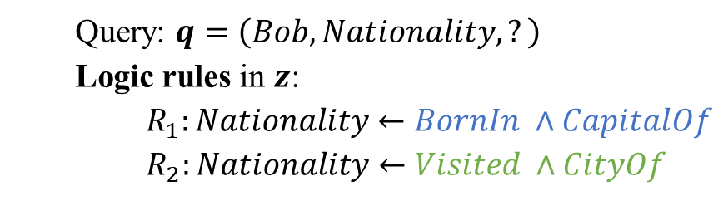


1. Background
Inductive reasoning method perform link prediction between new entities by learning logical rules[23] or local structural features[29].
Query: $q=\left(Bob, Nationality, ?\right)$
Logic rules in $z$:
$R_{1}:Nationality←BornIn ∧CapitalOf$
$R_{2}:Nationality←Visited ∧CityOf$
$${Query(e_{s},r}_{q},?)$$
$$r_{i}$$
CapitalOf
$$u_{1}$$
BornIn
Paris
France
$$r_{1}$$
CityOf
$$s$$
Visited
$$r_{2}$$
$$r_{3}$$
Bob
Lyon
Visited
$$r_{j}$$
$$u_{2}$$
$$u_{3}$$
CityOf
$$?$$
$$r_{k}$$
Montreal
Canada
Visited
CityOf
Local structural features
NYC
USA
[23]Meilicke C, Chekol M W, Ruffinelli D, et al. Anytime bottom-up rule learning for knowledge graph completion[C]//Proceedings of the 28th International Joint Conference on Artificial Intelligence. 2019: 3137-3143.
[29] Teru K, Denis E, Hamilton W. Inductive relation prediction by subgraph reasoning[C]//International Conference on Machine Learning. PMLR, 2020: 9448-9457.
Notes:
In recent years, inductive reasoning has garnered widespread attention.
These methods perform link prediction between new entities by learning logical rules or local structural features.
But these methods usually assume that only entities can be new, and that all relations should be observed during the training phase

Slide 6
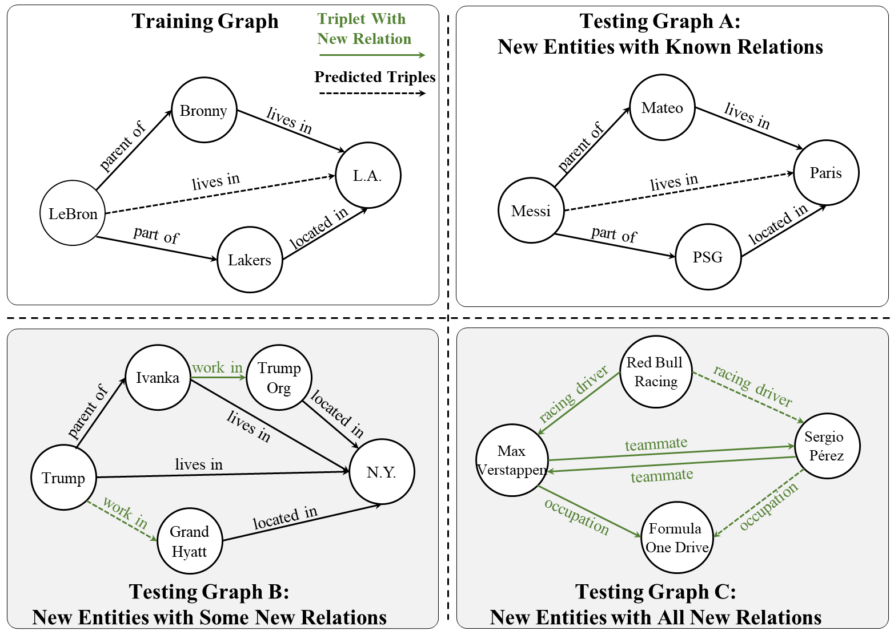
1. Background
Additional descriptions
or existing links
Without any background information
[19] Huang Q, Ren H, Leskovec J. Few-shot relational reasoning via connection subgraph pretraining[J]. Advances in neural information processing systems, 2022, 35: 6397-6409.
[20] Jaejun Lee, Chanyoung Chung, and Joyce Jiyoung Whang. 2023. InGram: Inductive knowledge graph embedding via relation graphs. In International Conference on Machine Learning. PMLR, 18796–18809.
Notes:
That is, most inductive reasoning methods are only able to handle scenarios such as that shown in the Testing graph A New Entities with Known Relations
They are difficult to handle when new entities and new relations emerge simultaneously, as shown in Testing Graphs B and C of Figure.（点击）
To generate embedded features for new relations such as those shown in Testing Graph B: New Entities with Some New Relations,
some methods typically need to rely on additional textual descriptions or a linkage mechanism to connect new relations to existing relations.（点击）
These methods still struggle with completely new relations as shown in Testing graph C that lack any background information, highlighting the need for a more generalizable approach.
Thus, our research addresses this by developing an embedding model which can generate embeddings for entities and relations that appear only in the testing phase, unseen during the training phase.
Knowledge Graph, as a typical directed graph, encapsulates a variety of simple but representative local structures that are crucial for learning graph representations. Specifically, adjacent relations may share common entities at either the head or tail positions, which can be used to represent the most basic form of interaction between relations or reflect some semantic relatedness. （点击）
For example, in the Training Graph, the tail entity of the “parent of” relation coincides with the head entity of the “lives in” relation. （点击）
Similarly, in Testing Graph C, the tail entity of the “racing driver" relation is also the head entity of the "teammate" relation.
Although new relations emerge during inference, the interaction patterns of relation-to-relation, such as head-to-head, and head-to-tail, remain consistent.

Slide 7
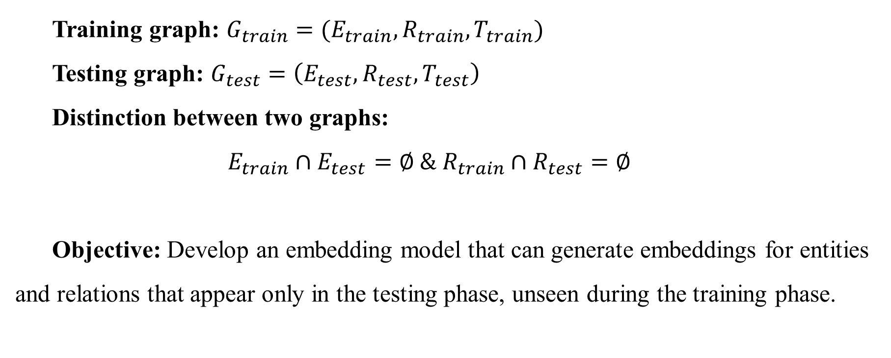
2. Task Definition
Training graph: $G_{train}=(E_{train},R_{train},T_{train})$
Testing graph: $G_{test}=\left(E_{test},R_{test},T_{test}\right)$
Distinction between two graphs:
$$E_{train}∩E_{test}=∅ \& R_{train}∩R_{test}=∅$$
Objective: Develop an embedding model that can generate embeddings for entities and relations that appear only in the testing phase, unseen during the training phase.
Notes:
Before introducing the method, let me explain the task definition of our work.
In our problem setting, we are given two graphs: a training graph and a testing graph.
Training Graph contains sets of entities and relations along with the corresponding set of training.
Testing graph includes a new set of entities, a set of relation and testing triples.
Our goal is to develop an embedding model that can generate embeddings for entities and relations that appear only in the testing phase, unseen during the training phase.

Slide 8
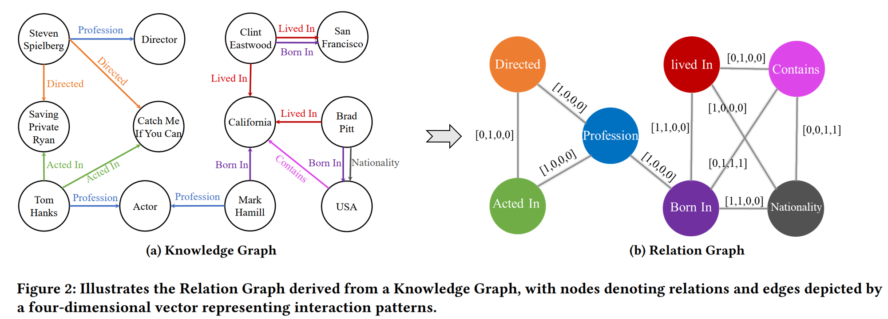

2. Method
$$P_{ij}=[p_{ij}^{\left(h2h\right)},p_{ij}^{\left(t2t\right)},p_{ij}^{\left(h2t\right)},p_{ij}^{\left(t2h\right)}]$$
Notes:
This page shows the main idea of this method. From the knowledge graph, we construct a relation graph to describe the interaction patterns. You can see the relation graph is the dual graph of the knowledge graph, and the nodes in the relation graph represent the relations in the knowledge graph. The weight of an edge in the relation graph is a four-dimensional vector, p_{ij}. The first dimension, p_{ij}^{H2H}, indicates if the two relations share the same head. The second dimension, p_{ij}^{T2T}, indicates if the two relations share the same tail. For example, the relations ‘Derived’ and ‘acted In’ here share the same tail, so the second dimension weight between ‘Derived’ and ‘acted In’ is 1. p_{ij}^{H2T} means the head of the first relation could be the tail of the second relation, and p_{ij}^{T2H} means the tail of the first relation could be the head of the second relation. We use this method to generate the relation graph, and this graph contain four-dimensional vectors representing the interaction patterns

Slide 9
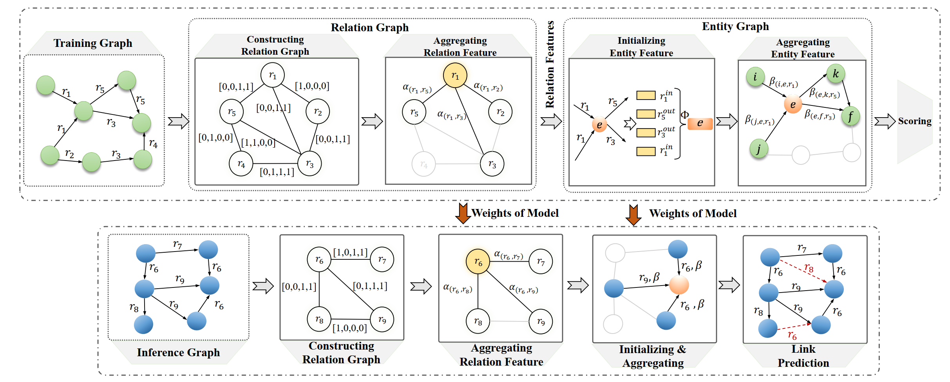
2. Method
Notes:
This the frame work of our method. First, we construct the relational graph. Then, we use a graph neural network to learn the embeddings of the relations. Next, we combine the representation of the relations with the original knowledge graph to obtain the embeddings of the entities. Finally, we use the embeddings of the entities and relations to calculate the score of the links we want to predict.

Slide 10
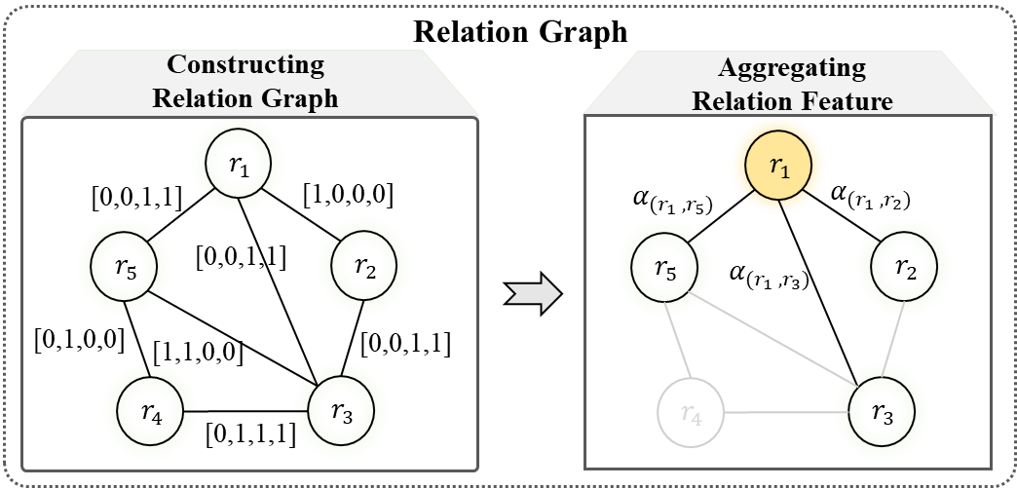
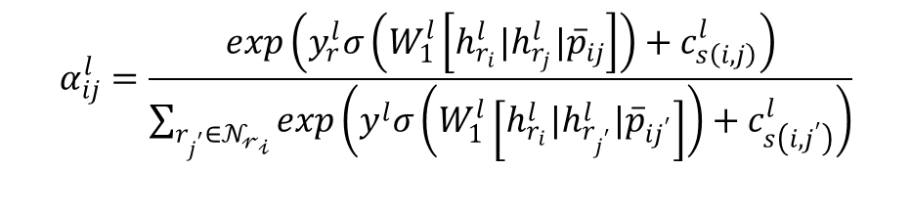
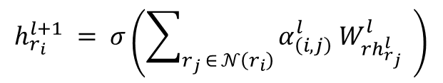

2. Method
Relation Feature Representation
Initialization
$$h_{r_{i}}=W_{r}^{0}r_{i}$$
Attention-based Aggregation
$$h_{r_{i}}^{l+1} = σ\left(\sum_{r_{j} ∈ 𝒩\left(r_{i}\right)}{α_{\left(i,j\right)}^{l} W_{rh_{r_{j}}^{l}}^{l}} \right)$$
$$α_{ij}^{l}=\frac{\exp\left(y_{r}^{l}σ\left(W_{1}^{l}\left[h_{r_{i}}^{l}|h_{r_{j}}^{l}|{\overline{p}}_{ij}\right]\right)+c_{s\left(i,j\right)}^{l}\right)}{\sum_{r_{j^{′}}∈𝒩_{𝓇_{𝒾}}}{\exp\left(y^{l}σ\left(W_{1}^{l}\left[h_{r_{i}}^{l}|h_{r_{j^{′}}}^{l}|{\overline{p}}_{ij^{′}}\right]\right)+c_{s\left(i,j^{′}\right)}^{l}\right)}}$$
Relation
features
Interaction
patterns
Affinity
scores
10
Notes:
For the Relation Feature Representation: We initialize the embedding of a relation with a sample from a normal distribution. Then, we use attention-based aggregation to aggregate neighors’ relation repesation . When we calculate the weight of the attention, we consider the last layer's relation embedding, interaction patterns (a 4-dimensional vector we created when we constructed the relation graph), and the affinity scores, which are manual features. We collected these features from statistical information."

Slide 11
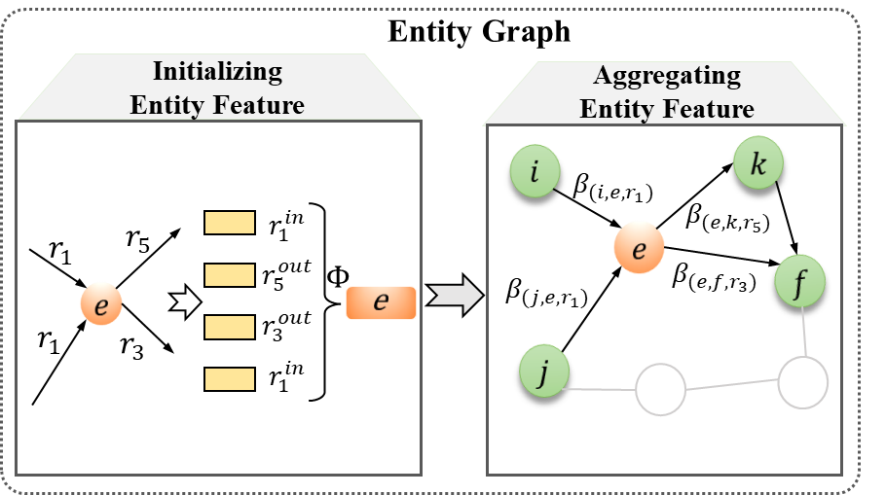
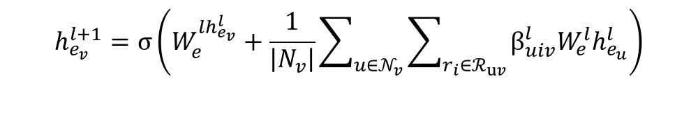

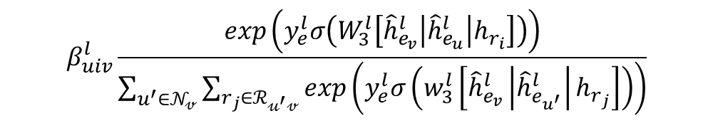
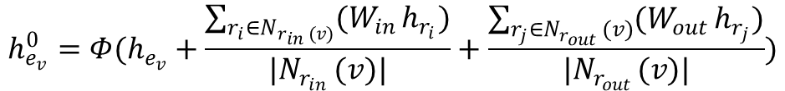
2. Method
Entity Feature Representation
Initialization:
$$h_{e_{v}}^{0}=Φ(h_{e_{v}}+\frac{\sum_{r_{i}∈N_{r_{in }(v)}}{(W_{in }h_{r_{i}})}}{|N_{r_{in }}(v)|}+\frac{\sum_{r_{j}∈N_{r_{out }}(v)}{(W_{out }h_{r_{j}})}}{|N_{r_{out }}(v)|})$$
Attention-based Aggregation:
$$h_{e_{v}}^{l+1}=σ\left(W_{e}^{lh_{e_{v}}^{l}}+\frac{1}{\left|N_{v}\right|}\sum_{u∈𝒩_{v}}{\sum_{r_{i}∈ℛ_{uv}}{β_{uiv}^{l}W_{e}^{l}h_{e_{u}}^{l}}}\right)$$
$$β_{uiv}^{l}\frac{\exp\left(y_{e}^{l}σ\left(W_{3}^{l}\left[{\hat{h}}_{e_{v}}^{l}\left|{\hat{h}}_{e_{u}}^{l}\right|h_{r_{i}}\right]\right)\right)}{\sum_{u^{′}∈𝒩_{𝓋}}{\sum_{r_{j}∈ℛ_{𝓊^{′}𝓋}}{\exp\left(y_{e}^{l}σ\left(w_{3}^{l}\left[{\hat{h}}_{e_{v}}^{l}\left|{\hat{h}}_{e_{u^{′}}}^{l}\right|h_{r_{j}}\right]\right)\right)}}}$$
$${\hat{h}}_{e_{v}}^{l}=W_{s}[h_{e_{v}}^{l}||s_{v}]$$
11
Notes:
For the entity feature representation, we use the relation representation obtained in the last phase to initialize the entity embedding. Then, we use an attention-based graph neural network to aggregate the neighboring entities and gather the new layer's entity representation.

Slide 12

2. Method
Scoring Function
$$L=\sum_{\left(e_{u},r_{i},e_{v}\right)}{\sum_{\left(e_{u}^{′},r_{i},e_{v}^{′}\right)}{max\left(0,γ−S\left(e_{u},r_{i},e_{v}\right)+S\left(e_{u}^{′},r_{i},e_{v}^{′}\right)\right)}}$$
S$\left(e_{u},r_{i},e_{v}\right)={\left({\hat{W}}_{e}h_{e_{u}}\right)}^{⊤}diag\left({\overline{W}}_{r}h_{r_{i}}\right)\left({\hat{W}}_{e}h_{e_{v}}\right)$
Training and Inference Regime
Learning to generate embeddings during the training phase
Using the learned weights to construct a relation graph and aggregate the features
Only utilizes the inherent semantic-agnostic structural information
12
Notes:
Our loss function is a margin-based ranking loss function. We want to maximize the positive triple score while minimizing the negative triple score. As you can see, during the training and inference phases, our model learns to generate embeddings. We use the learned weights to construct a relation graph and aggregate the features. One of The advantage of our method is that we only utilize inherent structure information, which is semantically agnostic.

Slide 13
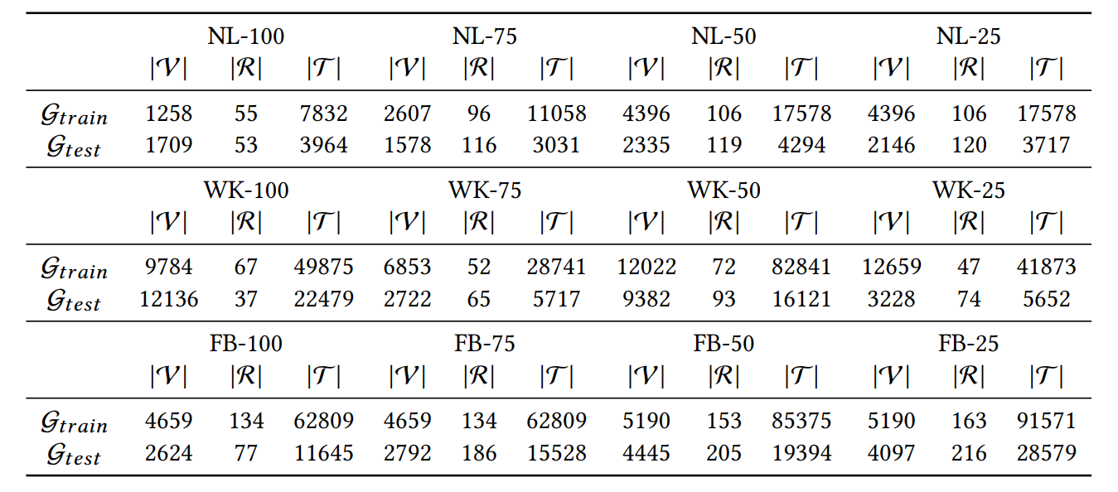
3. Experiments
Dataset
Experiments are conducted on the three datasets established by [20].
Each benchmark offers four distinct versions that delineate the percentage of new relations in the test triples: 100%, 75%, 50%, and 25%.
In addition, we validated the performance on two datasets NL-0 and NELL-995-v1 [29] that these only contain new entities without any new relations.
[20] Jaejun Lee, Chanyoung Chung, and Joyce Jiyoung Whang. 2023. InGram: Inductive knowledge graph embedding via relation graphs. In International Conference on Machine Learning. PMLR, 18796–18809.
[29] Teru K, Denis E, Hamilton W. Inductive relation prediction by subgraph reasoning[C]//International Conference on Machine Learning. PMLR, 2020: 9448-9457.
Notes:
We conducted our experiments on three datasets, and for each benchmark dataset, we provided four distinct versions with different percentages of new relations. For example, NL100 indicates that in the NL dataset, 100% of the relations are new, while NL25 indicates that in this test dataset, 25% of the relations are new.”

Slide 14
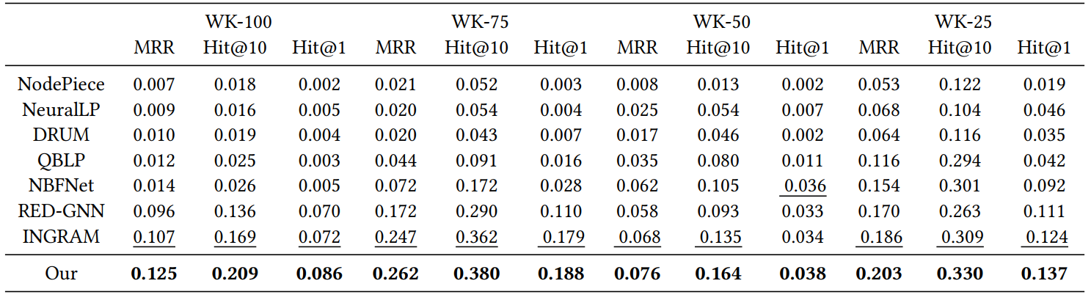
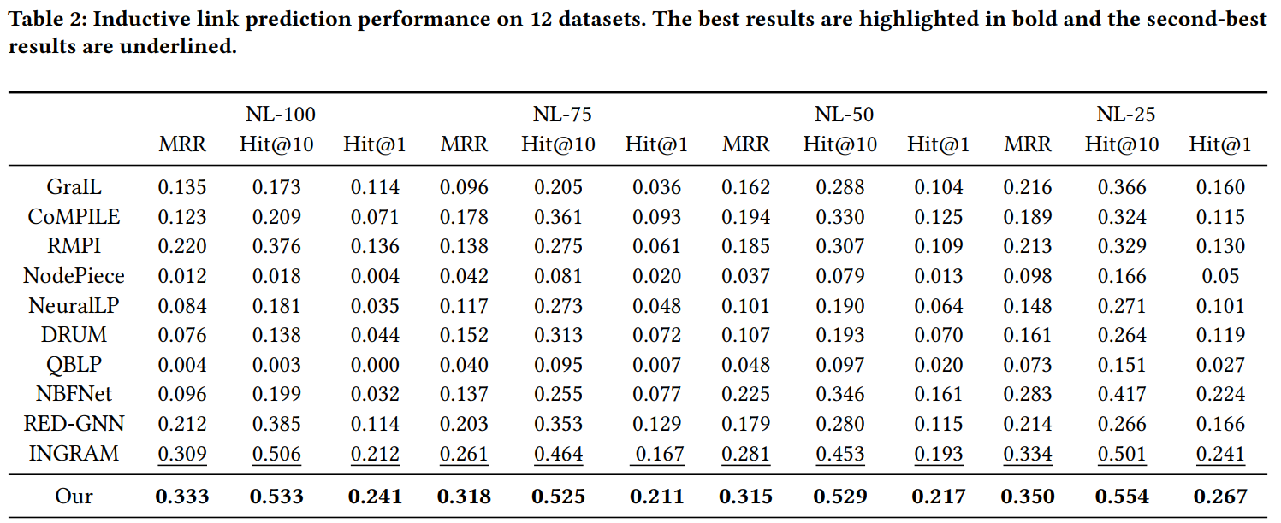
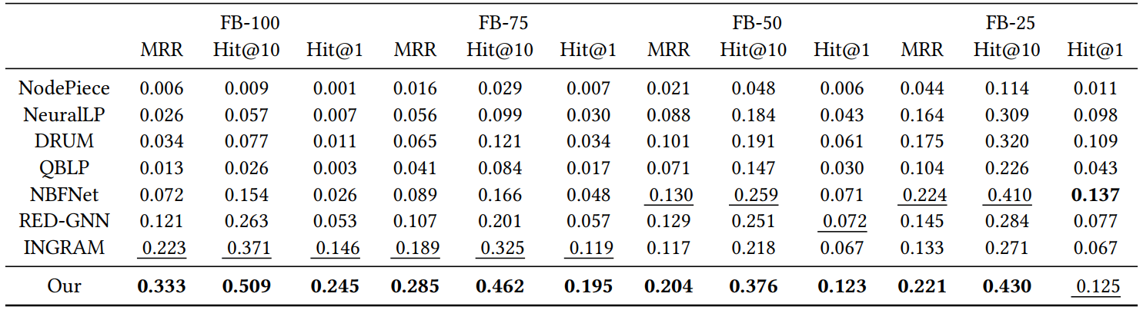
3. Experiments
Experimental Results and Analysis （With New Entities and New Relations）
Our model consistently outperforms all methods, including INGRAM, across all datasets.
The performance of our model is further highlighted on the NL-100, WK-100, and FB-100 datasets where all relations are new.
14
Notes:
The experimental results of the baseline methods and our model on three datasets are shown in Table 2. （点击）
From the table, we can observe the following: our model has achieved outstanding results.
Firstly, Our model consistently outperforms all methods across all datasets.
Secondly, the performance of our model is further highlighted on the NL-100, WK-100, and FB-100 datasets where all relations are new. This significant improvement is attributed to the ability of our models to capture subtle interactions between relations and utilize the local structural information of the entities in the graphs.

Slide 15
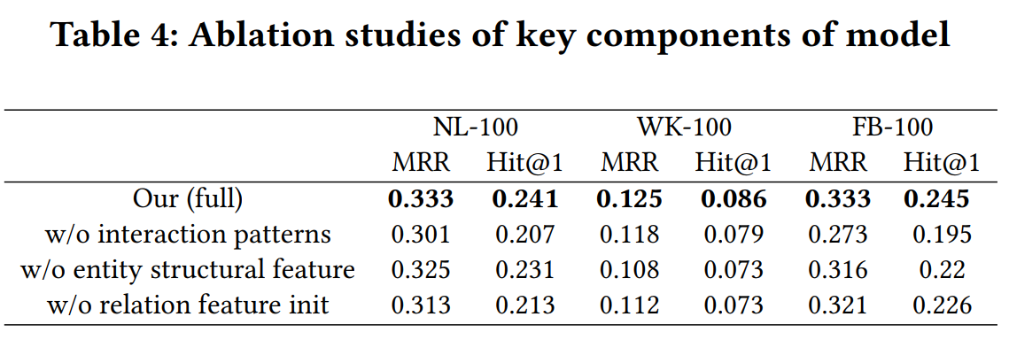
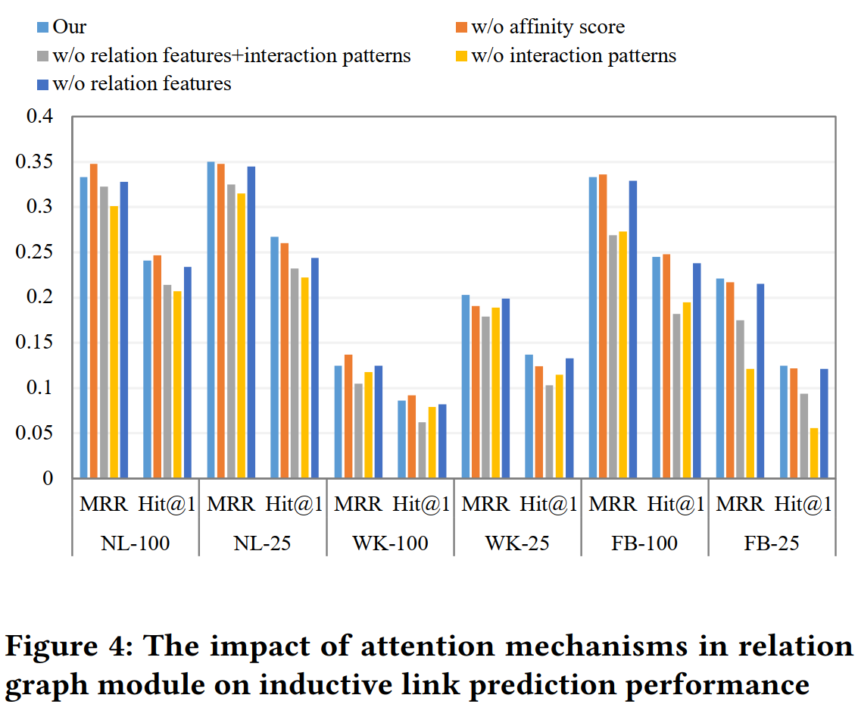
3. Experiments
Ablation Studies
Removing the interaction patterns between relationships ("w/o interaction patterns") has the most profound impact.
The performance of the two variants that remove the relation interaction pattern declines sharply.
15
Notes:
We conducted ablation studies on the NL-100, WK-100, and FB-100 datasets.（点击） The results shown in Table 4 indicate that ignoring the interaction patterns between relationships ("w/o interaction patterns") has the most profound impact on model performance, with significant decreases in both MRR and Hit@1 scores observed across three datasets.
The ablation study shows the important value of the relation graph we constructed.

Slide 16
4. Conclusion
By capturing the interaction patterns between relations and integrating entity structure features, our model can generate embeddings for new entities and relations that have not been seen during the training phase by attentively aggregating neighboring features.
This process only utilizes the inherent semantic-agnostic structural information within KGs and does not require any input semantic information about entities and relations.
16
Notes:
In conclusion, we present an innovative knowledge graph embedding approach to address the challenges of reasoning with new entities and relations.
By capturing the interaction patterns between relations and integrating entity structure features, our model can generate embeddings for new entities and relations that have not been seen during the training phase by attentively aggregating neighboring features. (点击)
This process only utilizes the inherent structural information within KGs and does not require any input semantic information about entities and relations.

